Slide 1

Final Year Project on Automatic Hand Sanitizer Dispenser Using Arduino
Indian Institute Of Engineering Science and Technology, Shibpur
Department of Electronics and Telecommunication Engineering
Presented By:- 1) Ankit Prasad – 510717013 2) Rohan Kumar Jaiswal - 510717020 3) Sumit Bhowmik – 510717027 4) Vidwita Srivastav – 510717024
Project Mentor – Dr Santanu Das
(Professor)

Slide 2
Contents
Particulars
Introduction
Components Used
Circuit Diagram
Code
Cost of the Project
Amelioration
Applications
Conclusion
References

Slide 3
Introduction
The COVID-19 pandemic has radically affected life for almost everyone around the globe, and makers are no exception.
With everyone being more careful of their interactions with humans and objects, personal hygiene has taken serious precedence over all other factors in public space. A lot of public places have hand sanitizers for visitors, but they need to be manually pressed.
To avoid any contact at all, some no-touch hand sanitizer dispensers are commercially available, but they are expensive and most off-the-shelf commercial sanitizers cannot be automated.
In this project, we create a contactless hand sanitizer dispenser that can be used for any press-to-release hand sanitizer available in the market.
The project uses an Arduino Uno, an HCSR04 Ultrasonic sensor, and a servo motor. The system is adjustable to accommodate most sanitizer bottles.

Slide 4

Water Stress in India
Sanitizers are the pickup option for places with water stress. In India alone 54% faces high to extremely high water stress.

Slide 5
Components Used:
Arduino Uno
Ultrasonic Sensor HC-SR04
Jumper Cables
Servo Motor MG995
Breadboard
Dispenser
USB Cable

Slide 6
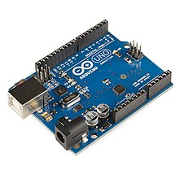
Q) What is an Arduino Uno?
The Arduino Uno is an open source microcontroller board based on the Microchip ATmega328P microcontroller and developed by Arduino.cc. The board is equipped with sets of digital and analog input/output (I/O) pins that may be interfaced to various expansion boards (shields) and other circuits. The board has 14 digital I/O pins (six capable of PWM output), 6 analog I/O pins, and is programmable with the Arduino IDE (Integrated Development Environment), via a type B USB cable. It can be powered by the USB cable or by an external 9V Battery, though it accepts voltages between 7 and 20 volts.

Slide 7
Pin Description
Pin Category | Pin Name | Details
Power | Vin, 3.3V, 5V, GND | Vin: Input voltage to Arduino when using an external power source. 5V: Regulated power supply used to power microcontroller and other components on the board. 3.3V: 3.3V supply generated by on-board voltage regulator. Maximum current draw is 50mA. GND: ground pins.
Reset | Reset | Resets the microcontroller.
Analog Pins | A0 – A5 | Used to provide analog input in the range of 0-5V
Input/Output Pins | Digital Pins 0 - 13 | Can be used as input or output pins.
Serial | 0(Rx), 1(Tx) | Used to receive and transmit TTL serial data.
External Interrupts | 2, 3 | To trigger an interrupt.
PWM | 3, 5, 6, 9, 11 | Provides 8-bit PWM output.
SPI | 10 (SS), 11 (MOSI), 12 (MISO) and 13 (SCK) | Used for SPI communication.
Inbuilt LED | 13 | To turn on the inbuilt LED.
TWI | A4 (SDA), A5 (SCA) | Used for TWI communication.
AREF | AREF | To provide reference voltage for input voltage.

Slide 8
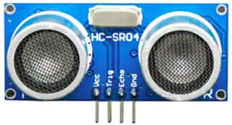
Q) What is an Ultrasonic Sensor?
An ultrasonic sensor measures the distance between its transmitter and an obstacle in front using ultrasonic sound waves (operational at 40 KHz) beyond the human audible sound wave range. The transmitter element sends out the ultrasonic wave which is reflected from the target and is picked up by the receiver module. Using the time-of-flight principle and the known speed of sound (~340 m/s), the distance between the sensor and the target is calculated.
(HC-SR04 Ultrasonic Sensor)

Slide 9
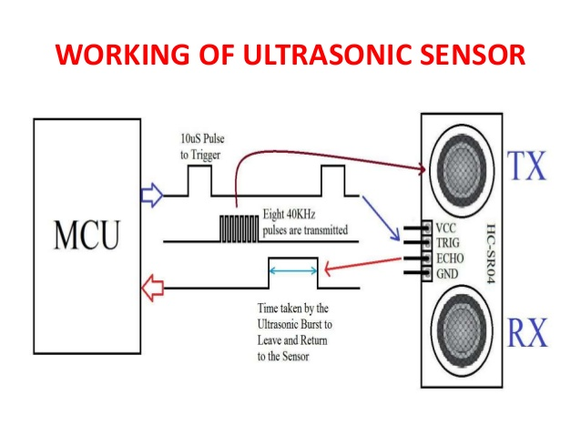
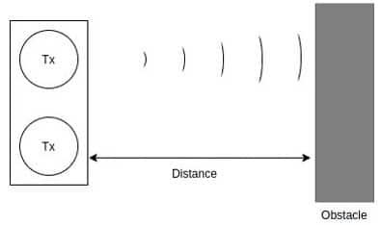
Q) How does the sensor work?
The HC-SR04 is a popular sensor among the maker community. Its operational field of view is essentially a straight line along the sensor’s line-of-sight. The sensor needs a 5 V power supply and has a Trigger and an Echo pin. The Trigger pin sends out a high ultrasonic pulse that is reflected and received by the Echo pin, which records the difference in time between the two events. The crystal visible on the module is responsible for the clock pulse. Sound waves can reflect off any air-other media boundary; thus, an ultrasonic sensor can also measure the distance from a water surface or glass.
The HC-SR04 module Trigger pin when set HIGH does not immediately set off an ultrasonic wave. Instead, a burst of 8 ultrasonic waves are sent out from the transmitter, invoked on the falling edge of the Trigger pin (after set HIGH). The minimum length of the Trigger pin HIGH pulse needed to invoke the ultrasonic pulse burst is 10 microseconds.
( Working principle of Ultrasonic Sensor)

Slide 10
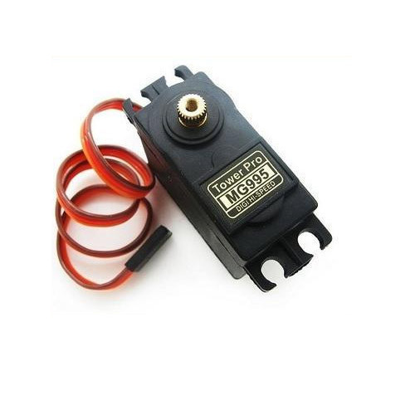
Q) What is a Servo Motor?
A servomotor is a rotary actuator or Linear actuator that allows for precise control of angular or linear position, velocity and acceleration. It consists of a suitable motor coupled to a sensor for position.
The MG995 is an 18 cm metal-geared servo motor. It provides a 2.8 kg-cm torque at 4.8 V and 3.2 kg-cm torque at 6 V power supply. The maximum speed of rotation is 0.18 seconds per 60° angle. The servo has three wires, brown, red, and orange for the connections to ground, 6 V power, and PWM signal respectively.
(MG995 Servo Motor)

Slide 11
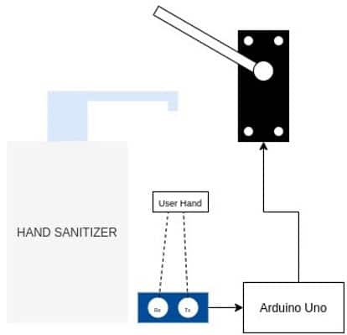
Q) How does the Automatic Dispenser Works?
The working principle of the automatic sanitizer dispenser is to actuate the servo to press the sanitizer tap whenever the sensor observes a low distance reading due to an obstruction in its line-of-sight. When a person’s hand comes below the sanitizer and obstructs the sensor line-of-sight, the Arduino board receives a low distance reading and instructs the servo motor to actuate and dispense the sanitizer.

Slide 12
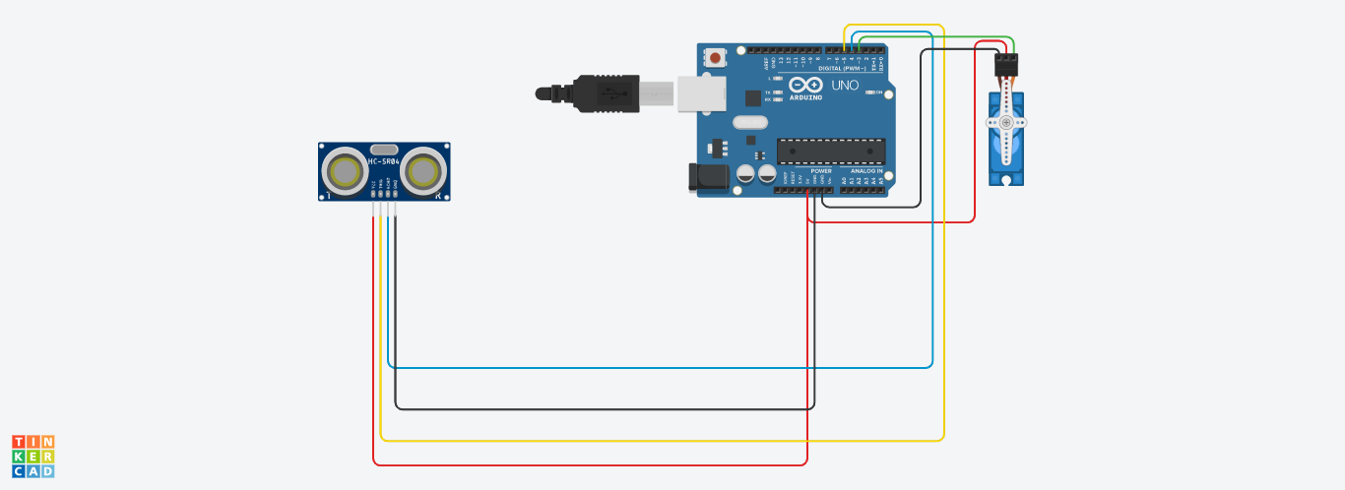
Circuit Diagram

Slide 13
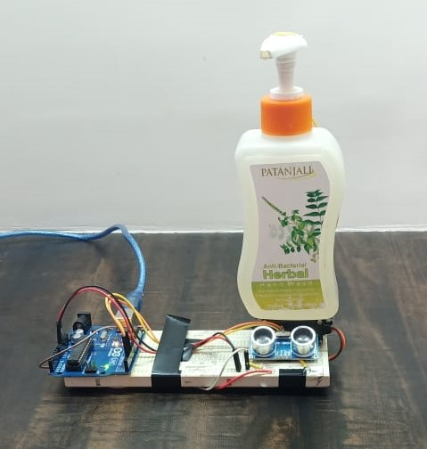
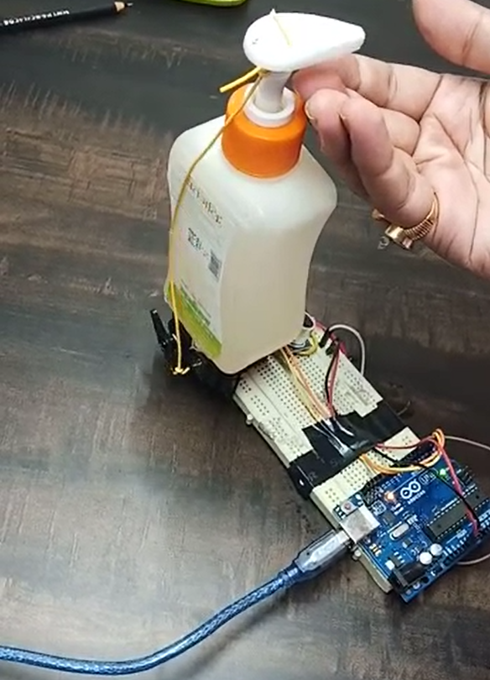
Front-side
Rear-side
Dispenser
Servo-motor
(MG-995)
Ultrasonic
Sensor(HC-SR04)
Arduino Uno
Breadboard
USB cable

Slide 14


Slide 15
Code
// This is the servo library we must include
#include <Servo.h>
// HC-SR04 Echo Pin & Trigger Pin connect to the Arduino Uno Digital Pins
#define echo_pin 2
#define trigger_pin 3
// Servo PWM
#define servo_pin 5
Servo servo_motor;
int pos1=0;
void setup() {
pinMode(trigger_pin, OUTPUT);
pinMode(echo_pin, INPUT);
Serial.begin(9600);
servo_motor.attach(servo_pin);
servo_motor.write(180);
}

Slide 16
void loop() {
// Write a pulse to the HC-SR04
digitalWrite(trigger_pin, LOW);
delayMicroseconds(5);
digitalWrite(trigger_pin, HIGH);
delayMicroseconds(10);
digitalWrite(trigger_pin, LOW);
// Measure the response from the HC-SR04 Echo Pin
float duration = pulseIn(echo_pin, HIGH);
// Here we are calculating the distance of the object from the sensor, the duration which we get is the round trip time, so we divide by 2 and then multiply by the speed of sound=343m/s or 0.0343cm/microsec
float distance = (duration/2) * 0.0343;
Serial.print("Distance =");

Slide 17
// If the distance read by the sensor is less than 15 cm and more than the minimum 3 cm, then it is assumed that there is a hand near the sanitizer
if ((distance > 3) && (distance < 15)) {
Serial.print(distance);
Serial.println(" cm");
// The next two loops is regarding the motion of our servo motor. First, it is Clockwise and then Anticlockwise to have a armature like movement
for(pos1=0;pos1<60;pos1+=1){
servo_motor.write(0);
delay(10);
}
for(pos1=60;pos1>=1;pos1-=1){
servo_motor.write(180);
delay(10);
}
}
else{
Serial.println("Out of range");
}
servo_motor.write(90);
delay(500);
}

Slide 18
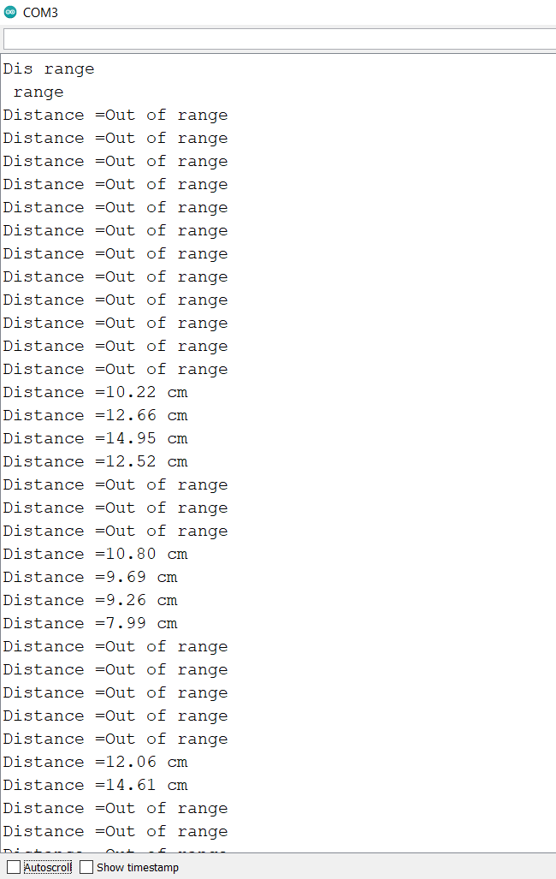
Serial Monitor Readings

Slide 19
Code Explanation
In the code above, the Trigger pin is set HIGH for 10 milliseconds to send an ultrasonic pulse. The Echo pin is then set HIGH by the pulseIn() method and when the reflected ultrasonic wave is received, the sensor sets the Echo pin LOW. The pulseIn() method is a blocking function and only returns when the Echo pin goes low and the time duration is measured.
Speed of sound = 340 m/s
The time between the wave sent out and the reflected wave received = T (in milliseconds from the Echo pin).
Distance = Speed of sound * T / 2 (Since the wave travels twice the distance between the reflecting object and the sensor)
Distance = T * 0.0343 / 2
Next comes the programing of the servo motor, so first, the motion is in Anti-Clockwise and then Clockwise motion so as to generate more torque at the cap of the dispenser.
Finally, we had given instruction to stop rotating when the hand is out of range.

Slide 20
Cost Of the Project
Components | Cost(Rupees)
Arduino Uno | 530
Ultrasonic Sensor HC-SR04 | 180
Servo Motor MG-995 | 481
Jumper Wires | 70
Breadboard | 180
Dispenser Bottle | 100

Slide 21
Improvements which can be done
We can replace the USB-cable, with Li-Ion rechargeable batteries to improve the portability of the project.
We can use a higher torque producing Servo-motor, which can pour out more sanitiser from the bottle and too easily.
We can give a better look to our project by covering the components by cardboard.
Insulation of circuit can be improved by better positioning of components.
We can also implement a spray type dispenser but it will add on the cost.

Slide 22
Applications
Can be used in Public Places like Malls, Shops, Stations , Airports etc.
Can be used at homes for guests.
Can be used in conjunction with automatic faucets in public restrooms.

Slide 23
Conclusion
Our project is a mini prototype of advanced industrialized automatic hand sanitizer available in the market, where we can add a lot of functions to it using IoT but due to COVID, we weren’t able to do it remotely and also difficulties in procuring equipment’s can’t be ignored.
In these times of social distancing and regular sanitization, this project gives the appropriate and revolutionized version of it where a person can sanitize himself/herself without actually touching the dispenser.
This project offers following positives:
Easy to use.
Cheap and reusable.
Maintains social distancing.
Delivers a standard dose.

Slide 24
References
https://www.wikipedia.org/
https://www.digikey.com/en/maker/blogs/
https://www.electrical4u.com/what-is-servo-motor/
https://www.fierceelectronics.com/sensors/what-ultrasonic-sensor#:~:text=An%20ultrasonic%20sensor%20is%20an,sound%20that%20humans%20can%20hear

